Slide 1
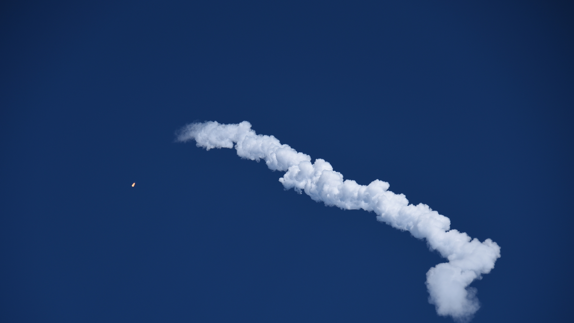
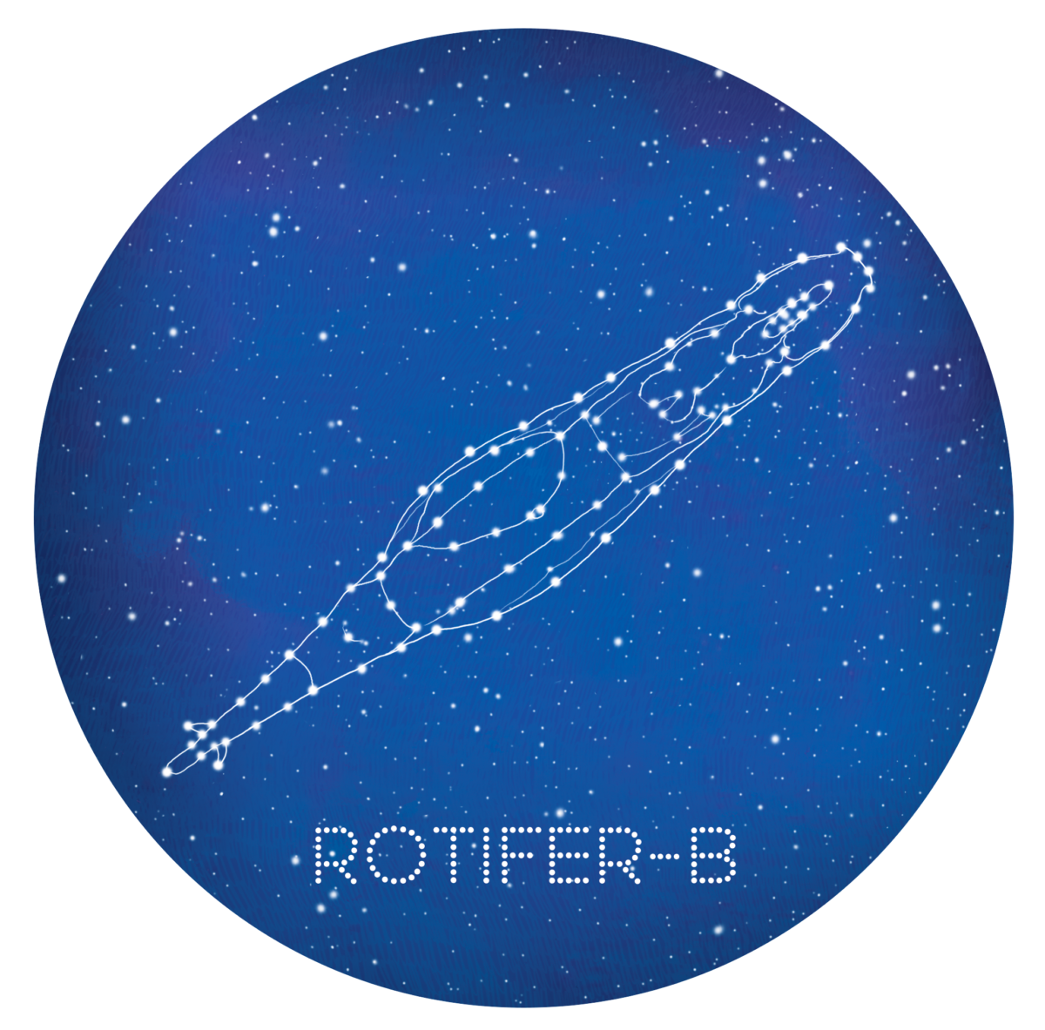
Rotifers In SpacE a new eukaryotic extremophile model organism to study the impact of radiation and micro-gravity on biological processes
B. Hespeels www.rotifer-in-space.com
ILEE Research Day – 11th February 2020

Slide 2
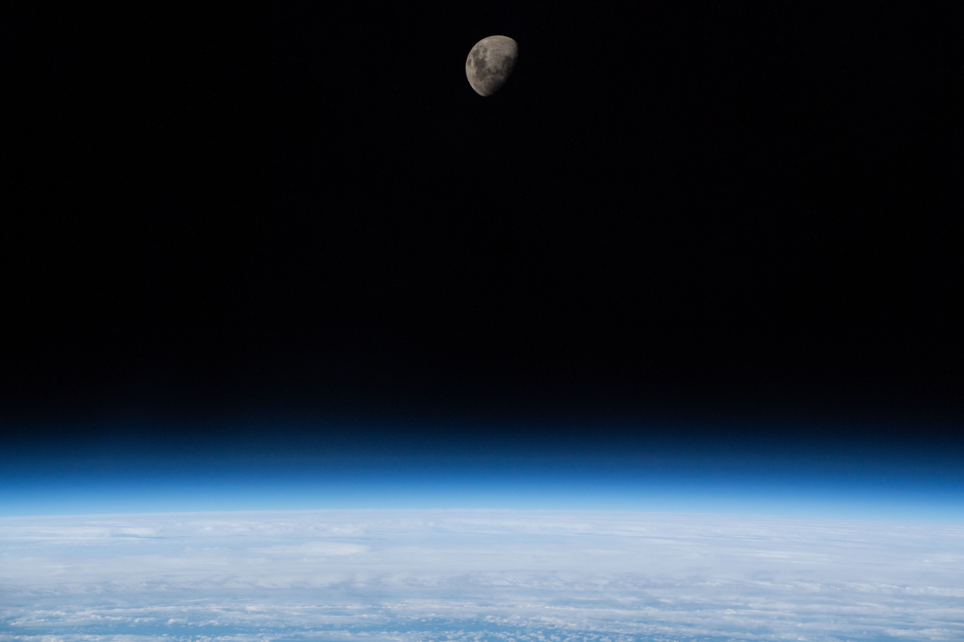
The space environment is hostile and unsuitable for humans

Slide 3
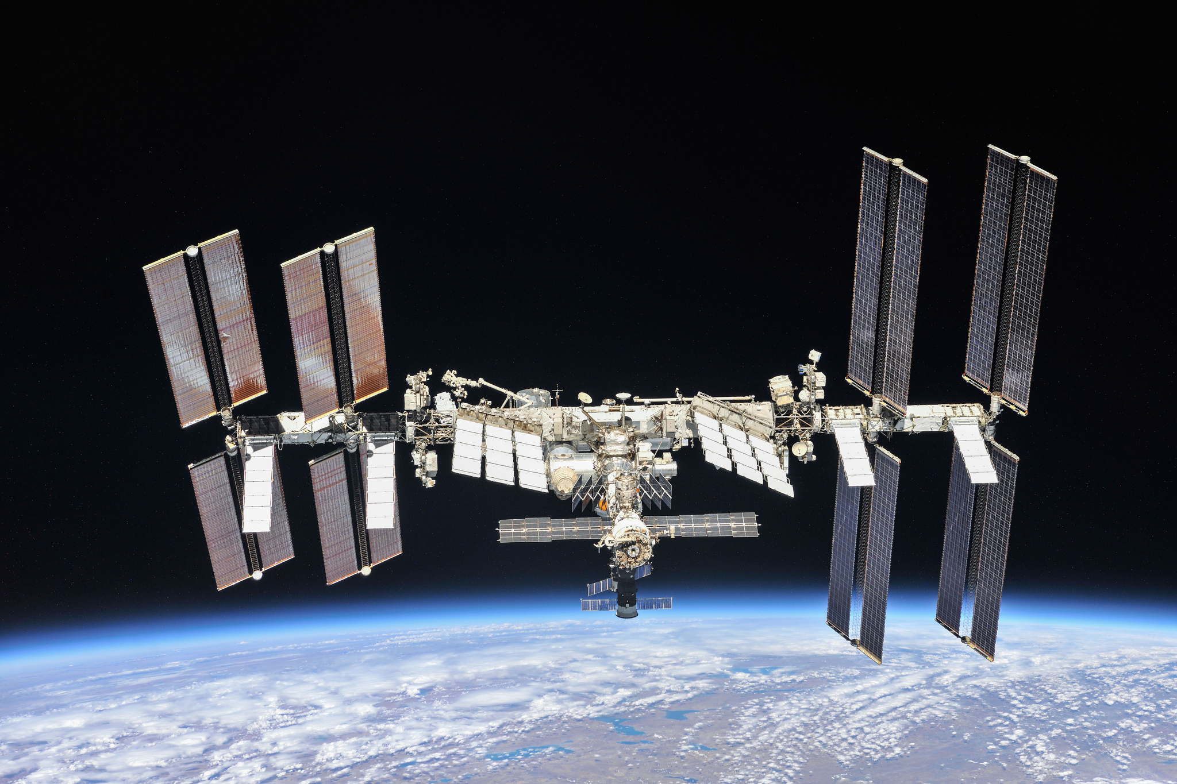
International Space Station (ISS)

Slide 4
International Space Station (ISS)

Slide 5
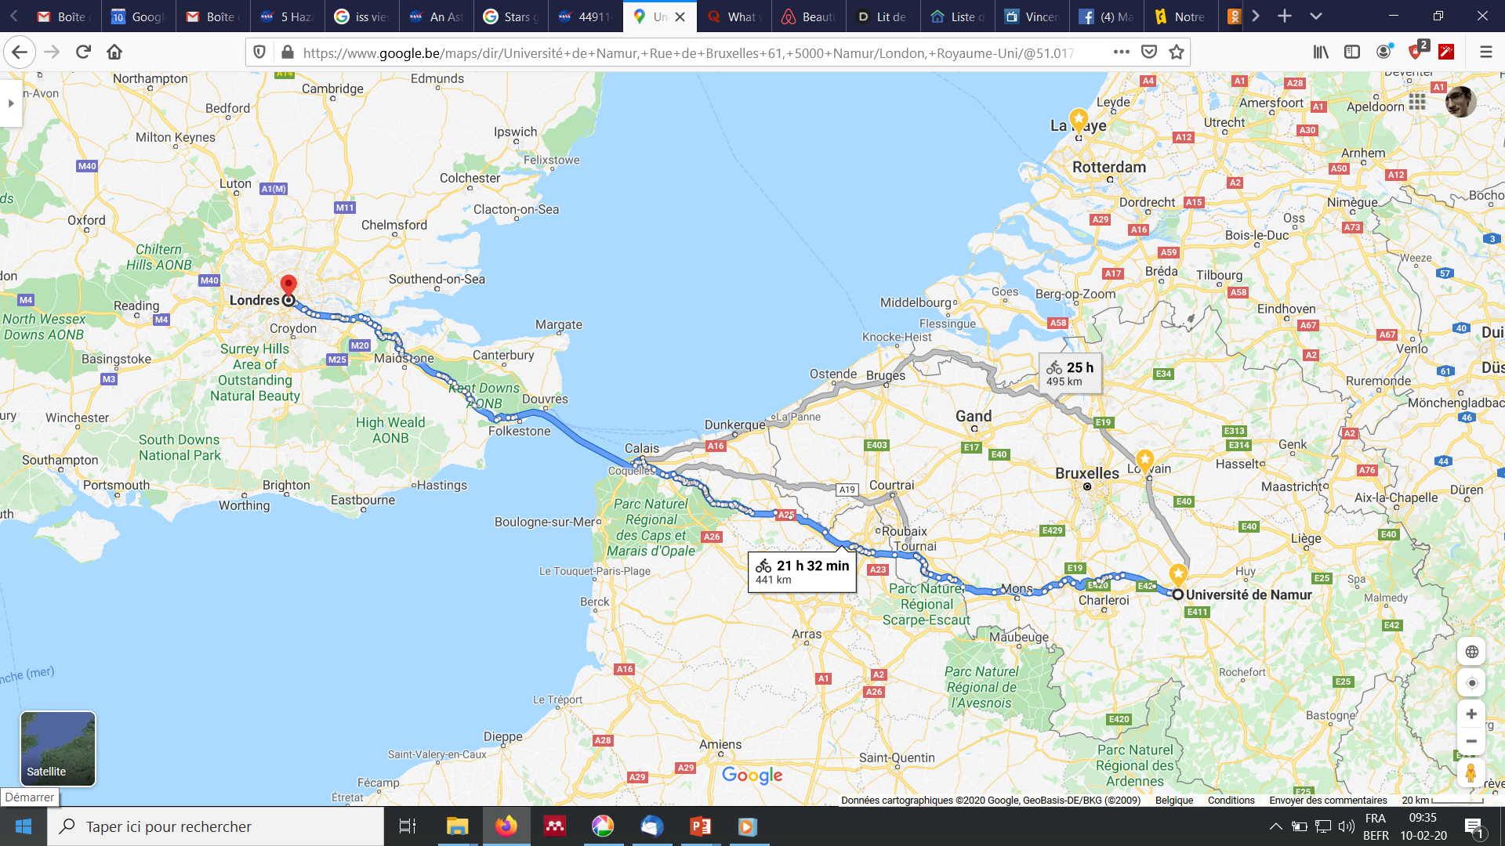
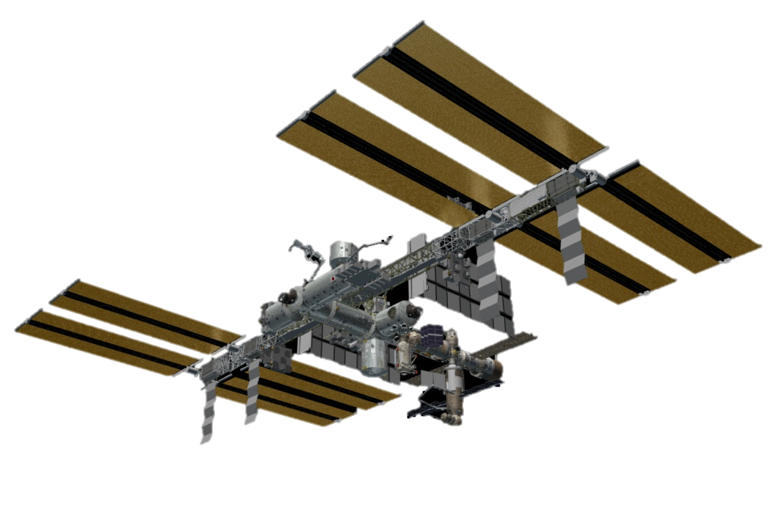
Going to Low Earth Orbit (LEO)
6-8h
2-6 days
*ISS and rockets not to scale

Slide 6
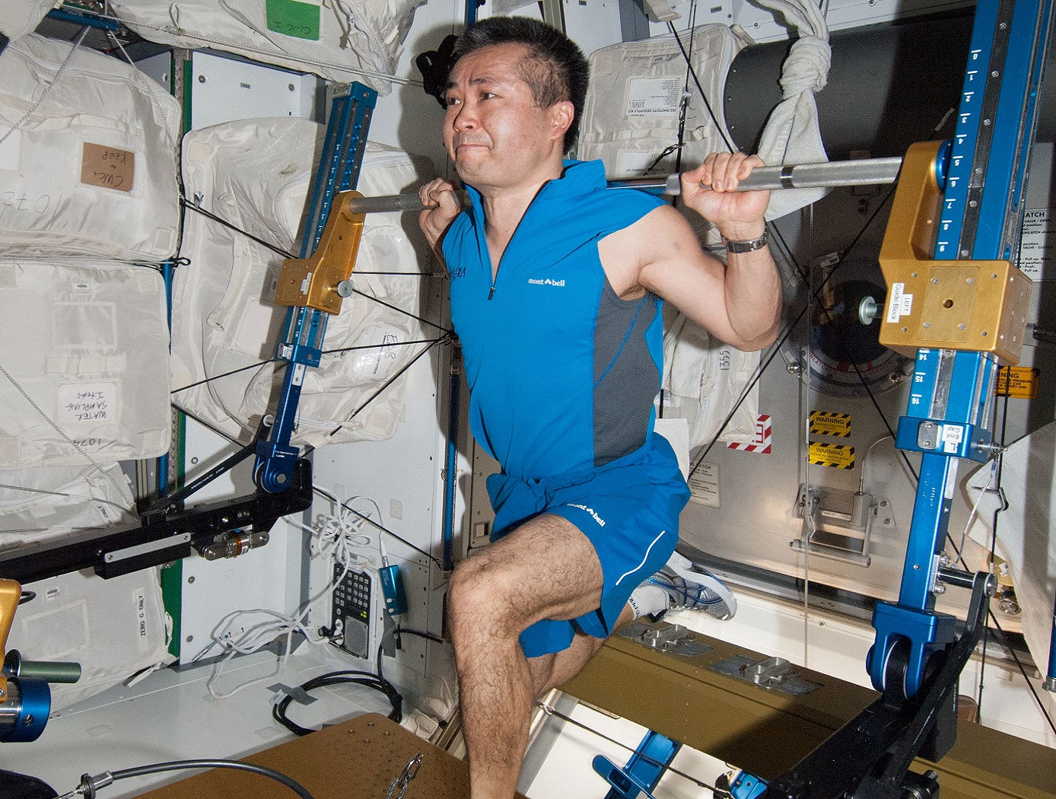
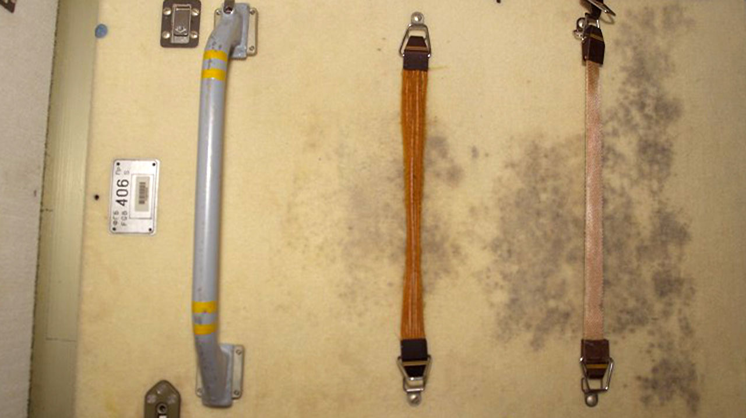
Space Chalenge
Long-term human Space missions depend on many parameters:
- µG
- High dose of radiation
Hostile Closed Environment
Mental
…
…
Dessay et al. 2005
Mold growing on the inside of the International Space Station. https://www.sciencemag.org/news/2019/06/space-station-mold-survives-200-times-radiation-dose-would-kill-human
Time-course of chromosomal aberration in a study on 22 Russian cosmonauts. Relationship between translocation frequency (WGE) and total duration of space sojourns for cosmonauts involved in multiple space flights. Each symbol represents a different cosmonaut. (George et al., 2007)
The International Space Station Advanced Resistive Exercise Device.
https://technology.nasa.gov/patent/MSC-TOPS-59

Slide 7
The NASA Twins Study: A multidimensional analysis of a year-long human spaceflight. Garrett-Bakelman et al., 2019 Science

Slide 8
The space environment is hostile and unsuitable for humans
Need of easy and comprehensive models

Slide 9
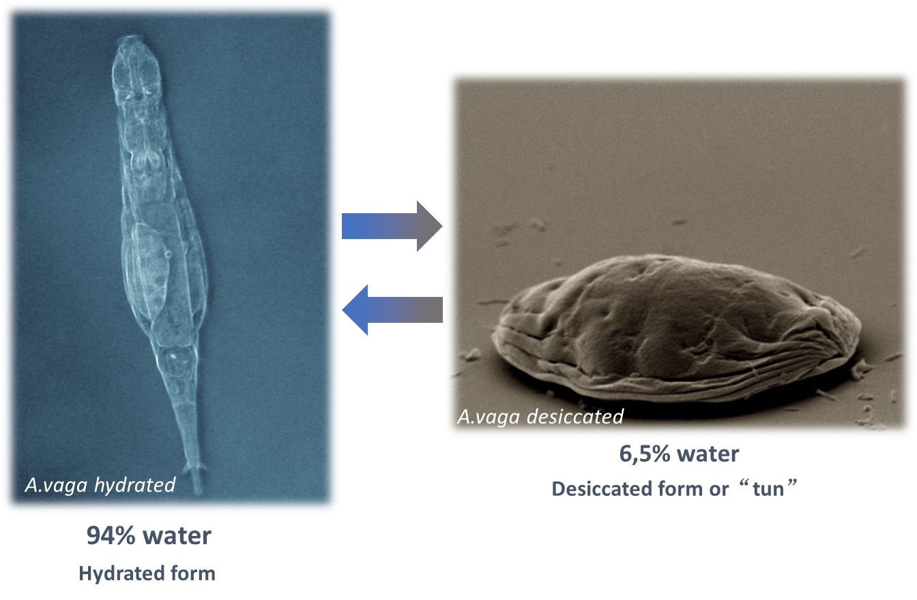
Adineta vaga as new model species for SPACE research

Slide 10
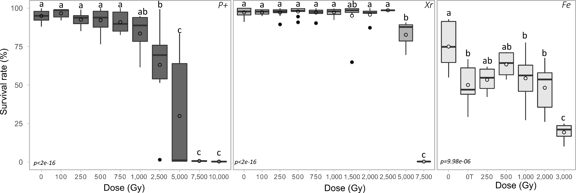
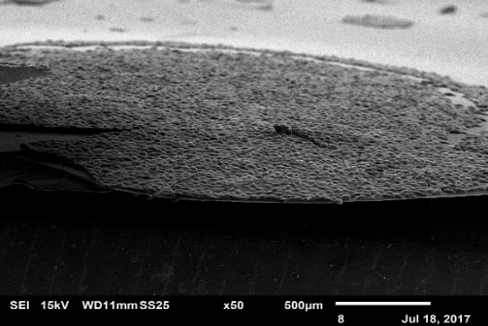
Iron Ladies – How desiccated A. vaga deal with X-rays and Heavy Ions?
Survival rate of A. vaga exposed to radiation
Desiccated A. vaga individuals. Survival rate 48h post rehydration
7500Gy=> Lethal dose X-ray and P+4Mev
Most human cells die between 1-10Gy…
Group of desiccated A. vaga individuals

Slide 11
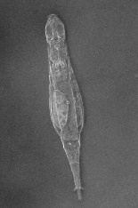
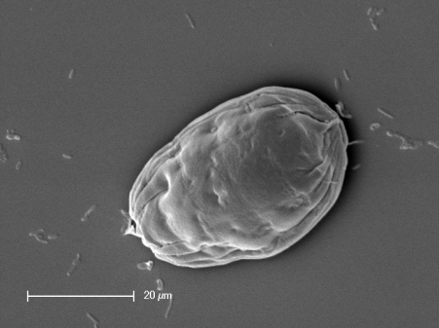
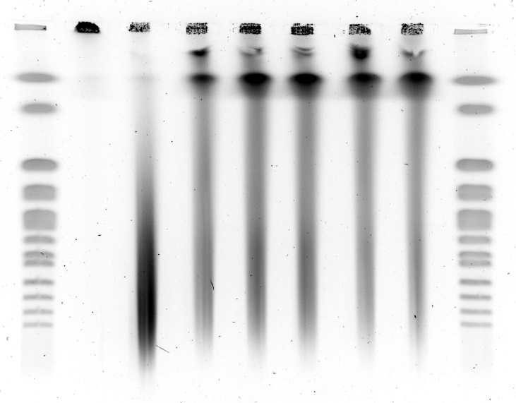
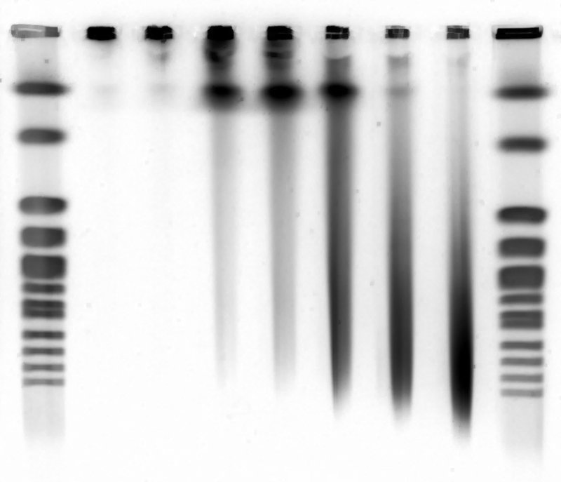
Bdelloid rotifers: desiccation and DNA repair
P+, alpha and X rays induce DNA DSBs and loss of genomic integrity
Sc Ctl 0h 8h 24h 48h 96h 168h Sc
2200
1600
1125
225
Kb
DNA DSBs
Hydrated bdelloid clones
Desiccated 'tuns'
Sc Ctl 0 50 100 250 500 800Gy Sc
2200
1600
1125
225
Kb
500 Gy exposure
Impact of radiation
on genomic integrity

Slide 12
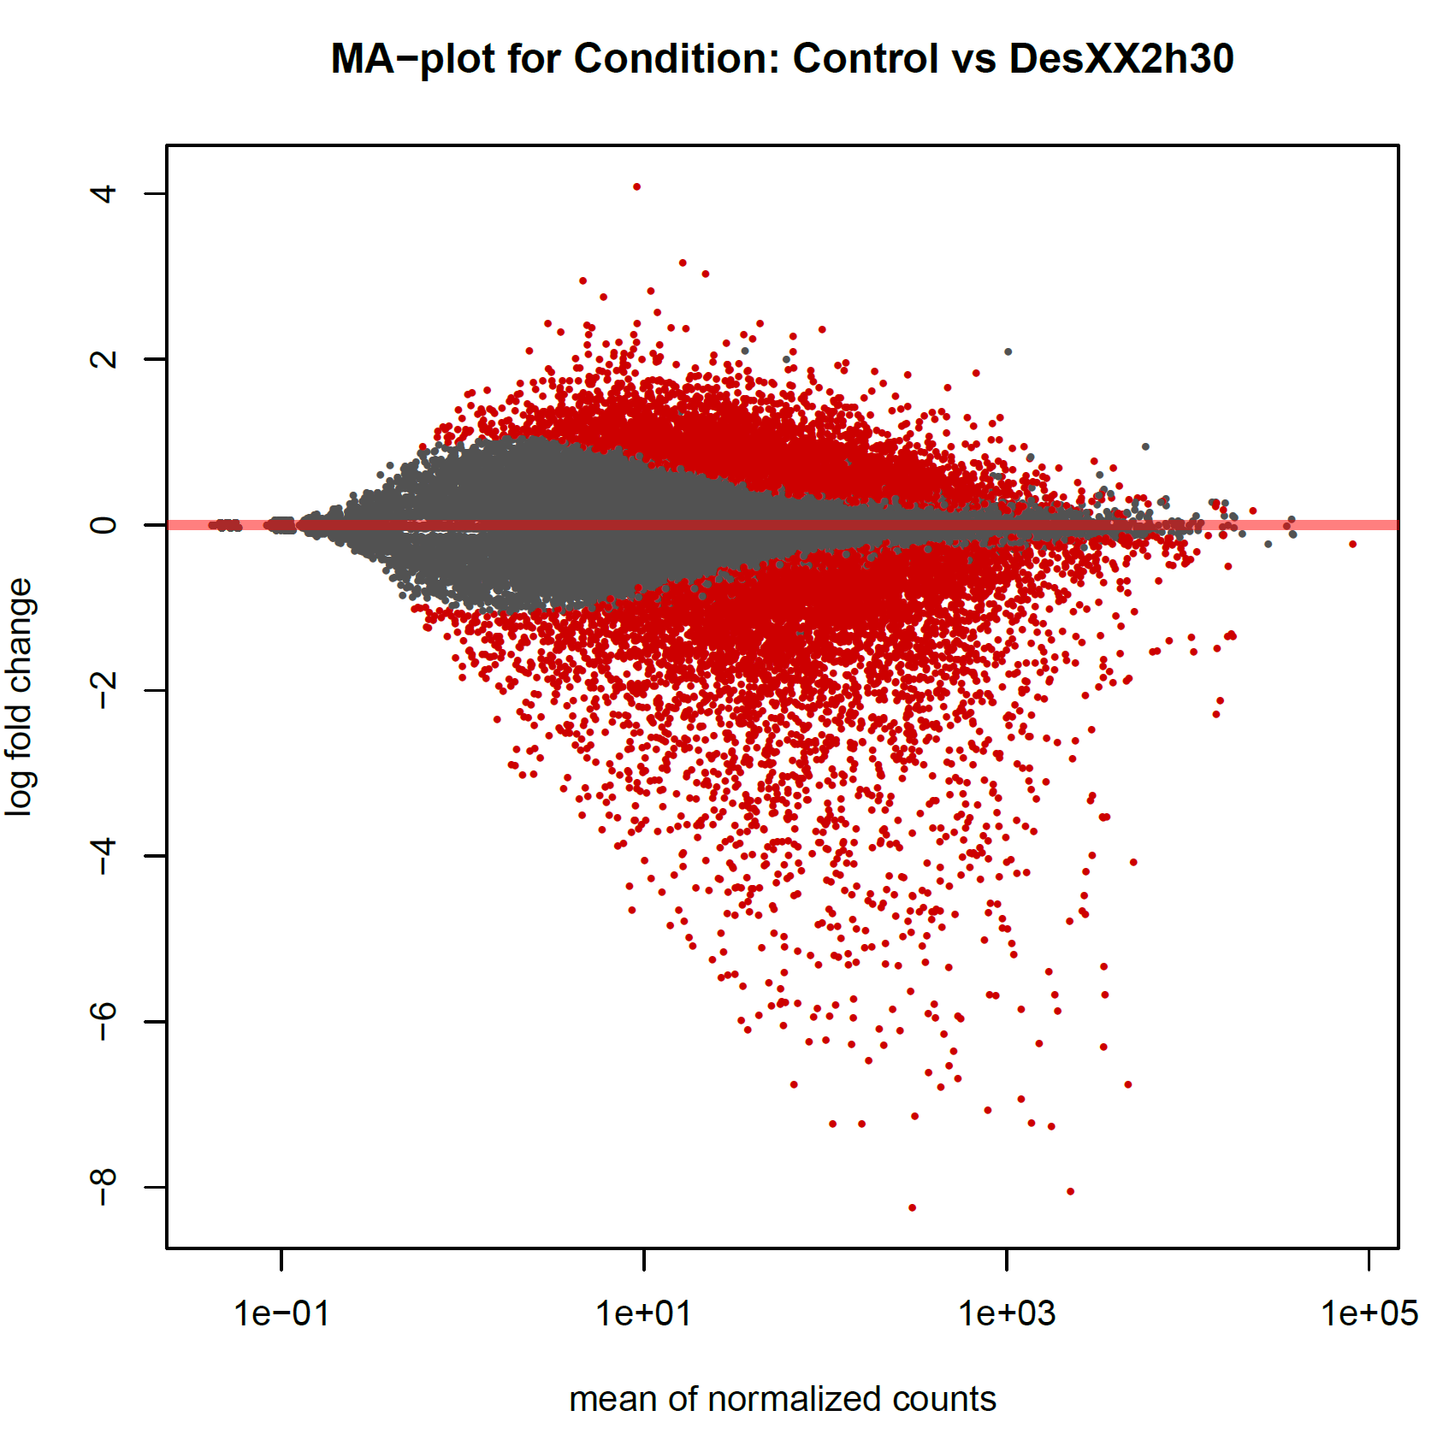
Using RNAseq and qPCR to decipher mechanisms of resistance
NHEJ
Ku70/80
XRCC4-Lig4

Slide 13
The space environment is hostile and unsuitable for humans
Need of easy and comprehensive model
Why not bdelloid?
“Nothing is easy in Space”

Slide 14
Summary of Rob1 experiment.
Key Question:
How spaceflight is affecting the gene expression of A. vaga individuals?
- sequencing of min 4 flight samples vs 4 ground samples)
=> Overview of RNA after space flight exposure.

Slide 15
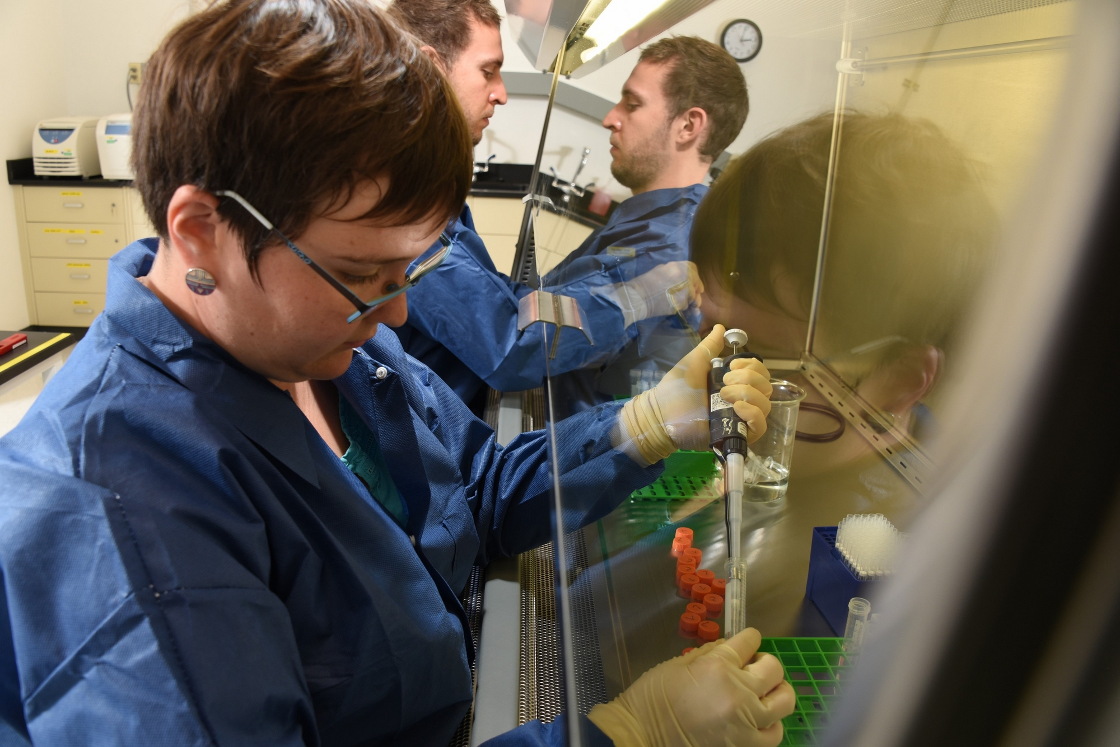
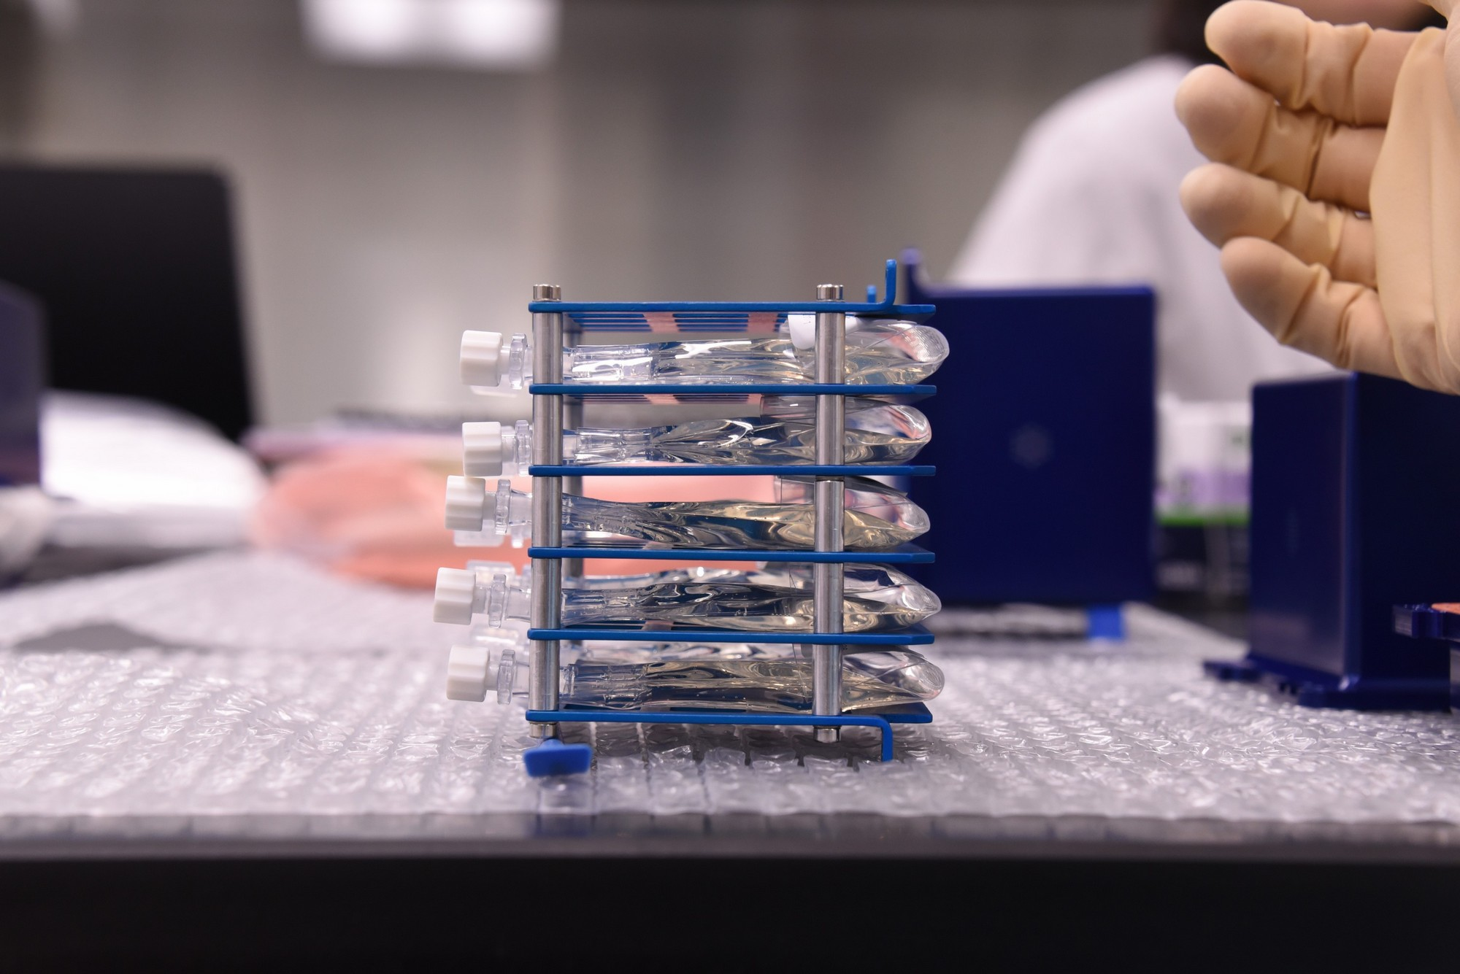
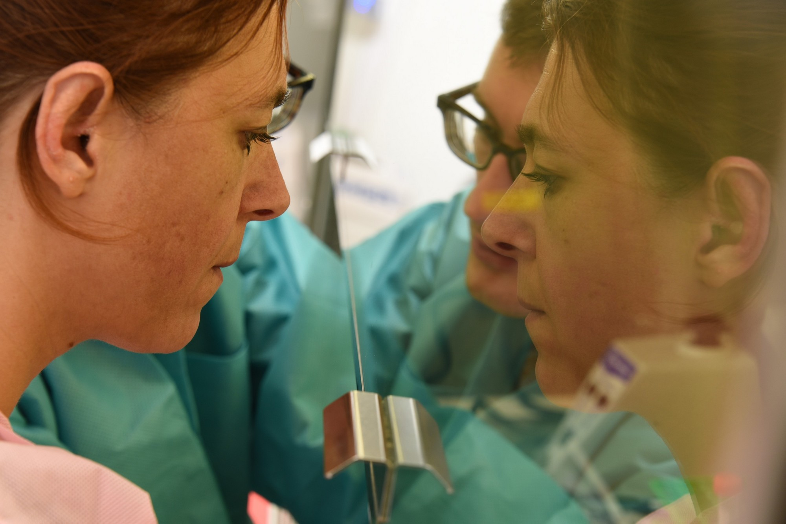
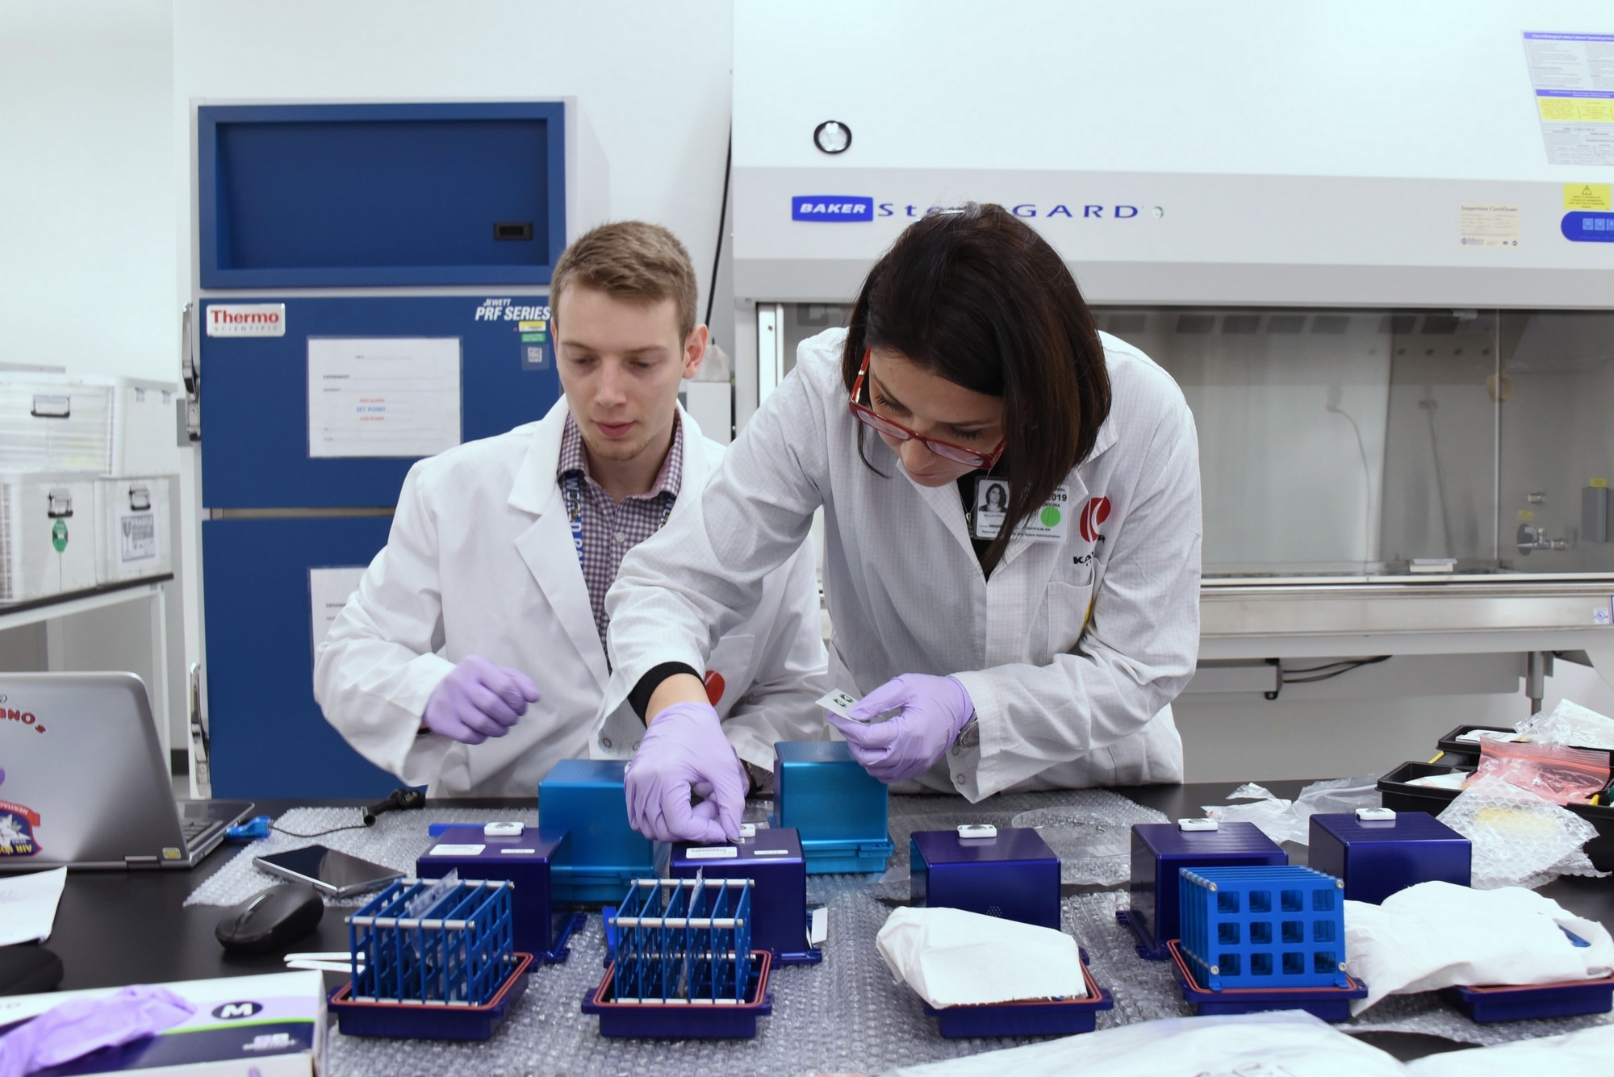
On-site cultivation and integration
Cooperation between many groups: NASA/ESA/SpaceX/Kayser Space/ …

Slide 16
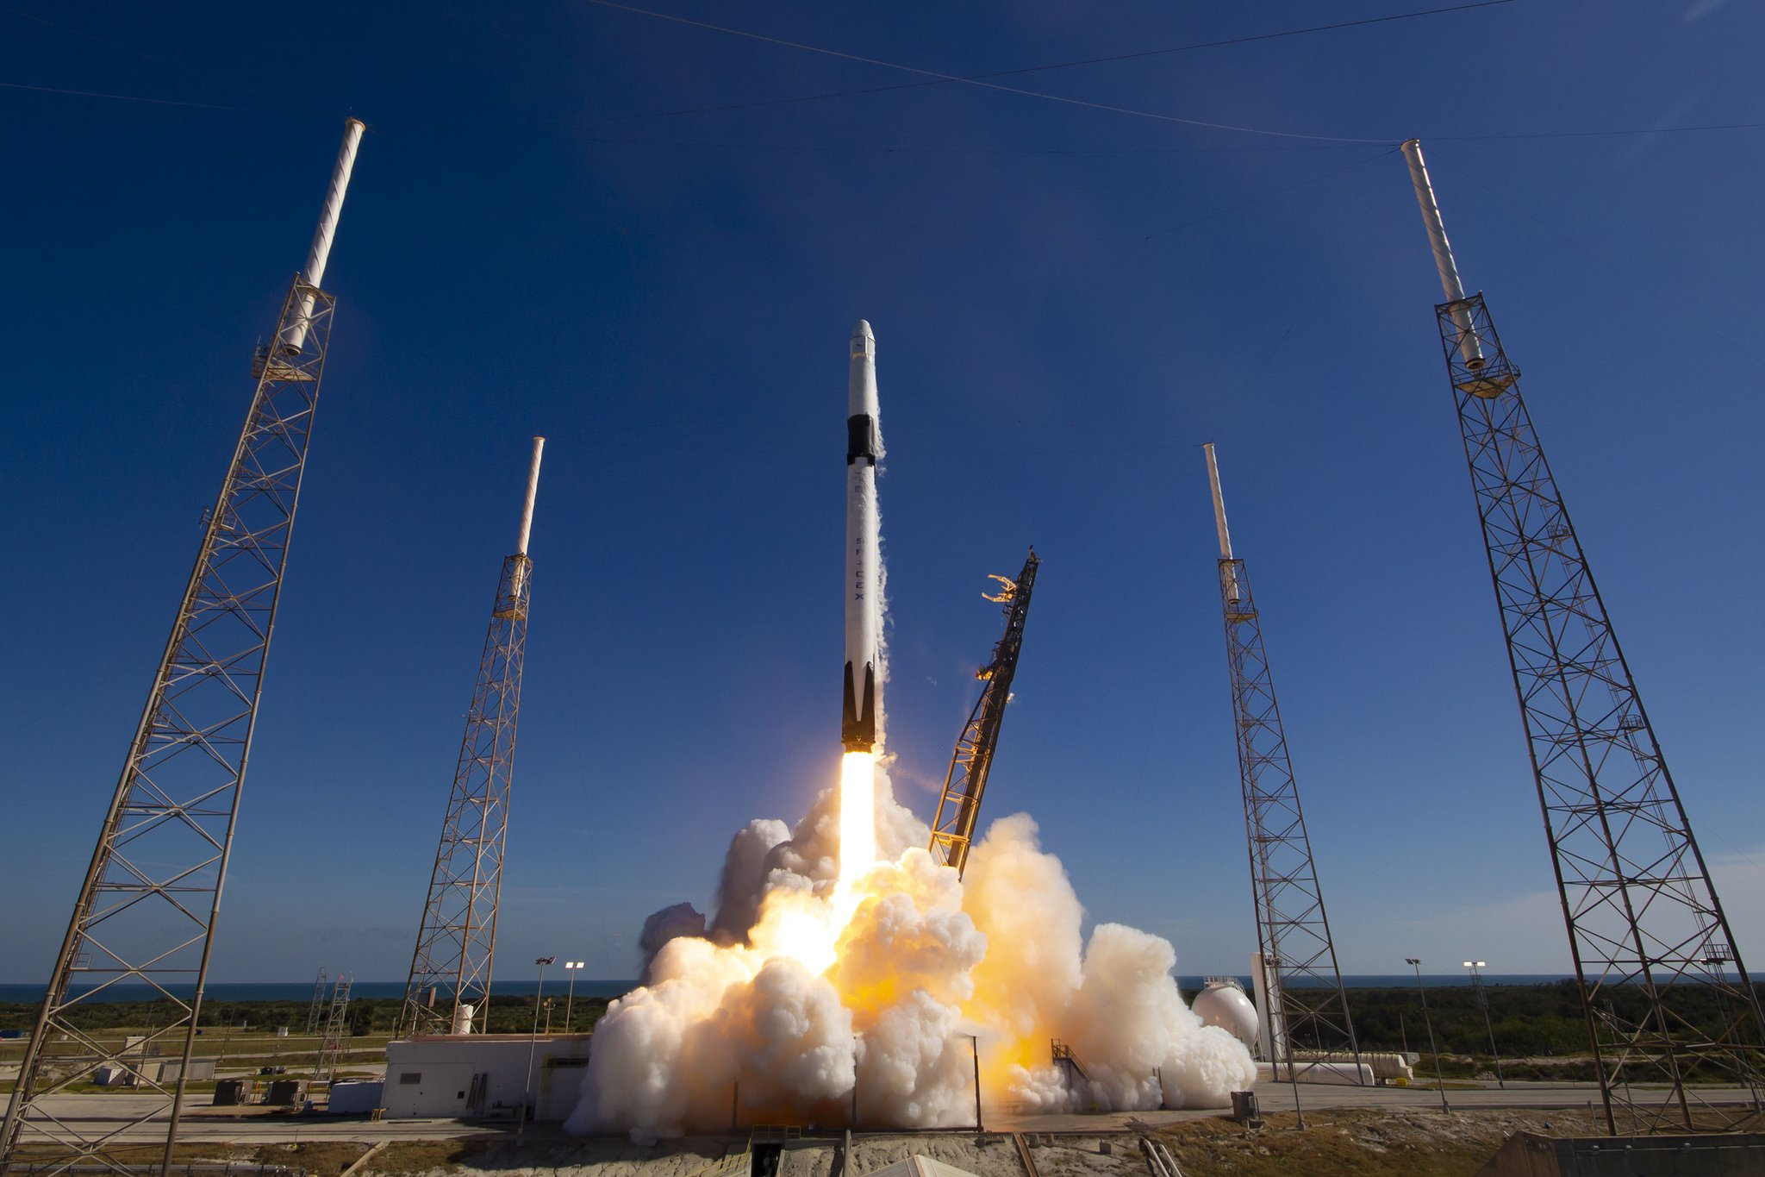
Launch and Docking
04/12/2019 Launch scrub
05/12/2019 17:29:24.521 UTC Launch
08/12/2019 Berthing ISS
Exposure of rotifer to µG 3 days until ISS docking.

Slide 17
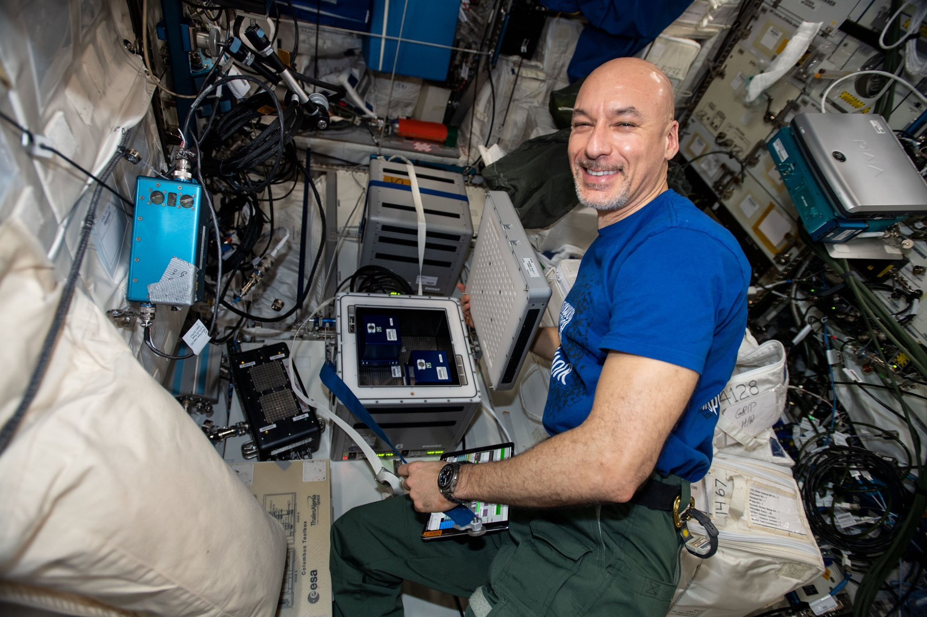
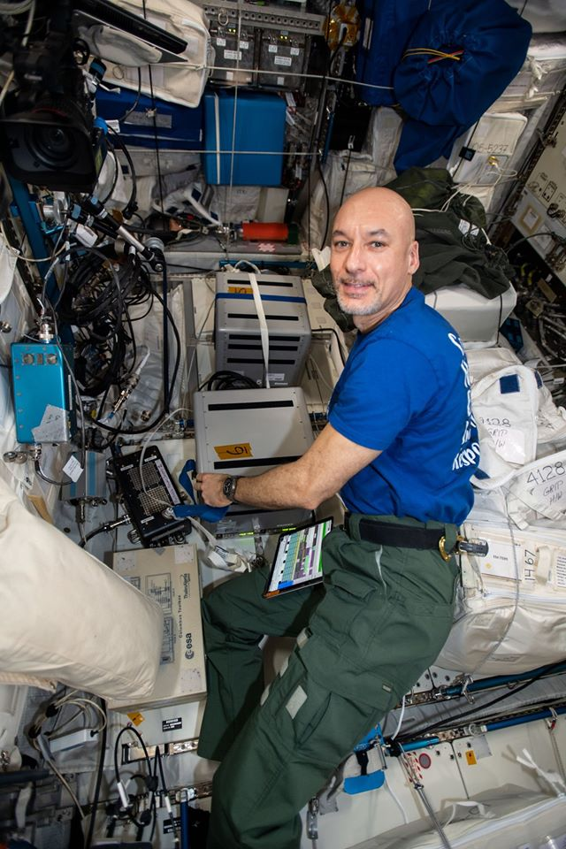
Incubation on board of ISS
Rotifers were installed inside Kubik container set at 15°C for a period of 1 week.
10-12-2019 GMT11:15-11:30
Astronaut Luca Parmitano – Rob 1 – Kubik Incubator

Slide 18
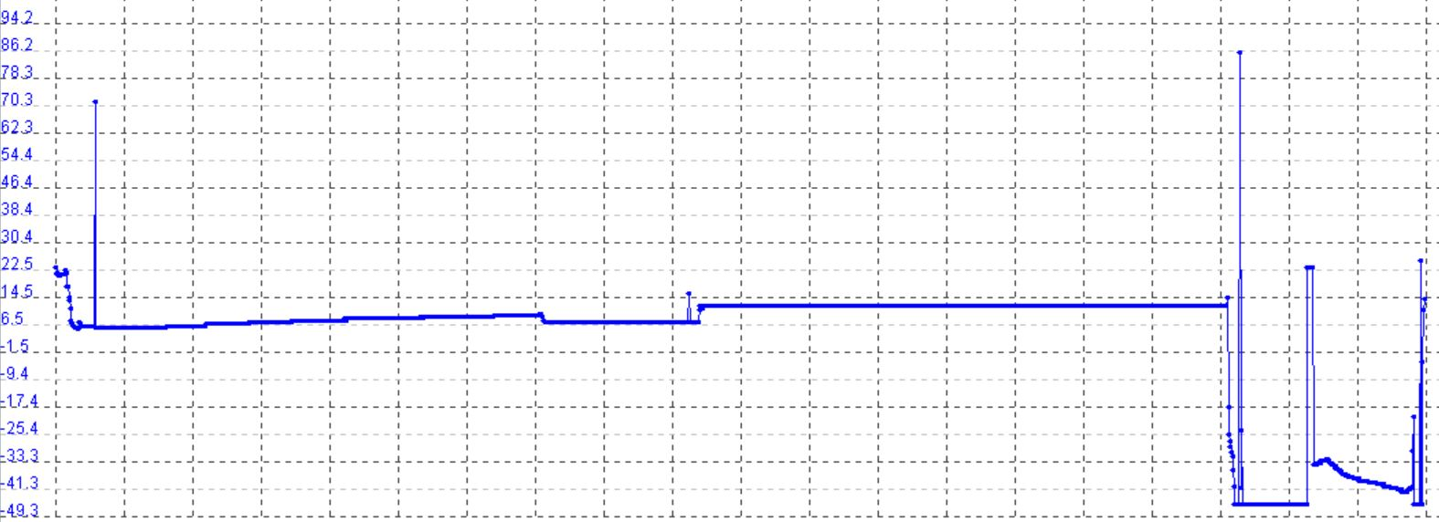
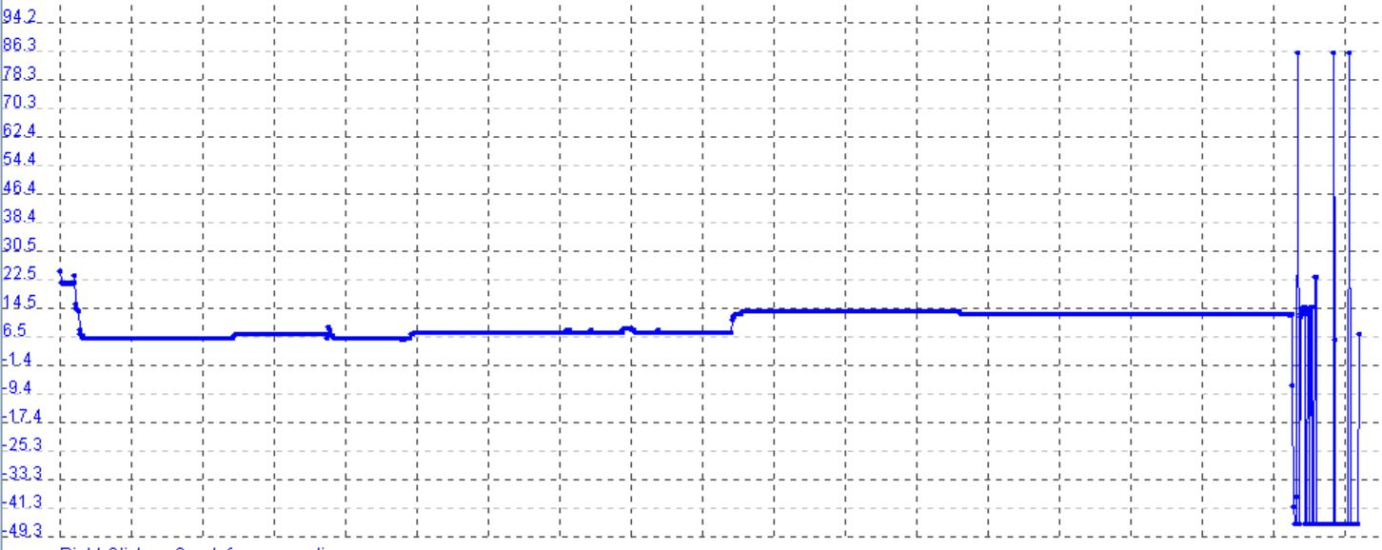
Fixation and Ground controls
Temperature
17/12/2019 GMT 11:12 => Fast freezing Melfi -80°C
Total duration of space exposure 12 days
Delivery to Unamur 14/01/2020
…
iButtons data show similar t° in flight and ground controls
Kubik 15°C
Melfi
Cold Storage
15°C exposure
-80°C
Storage KSC
Time

Slide 19
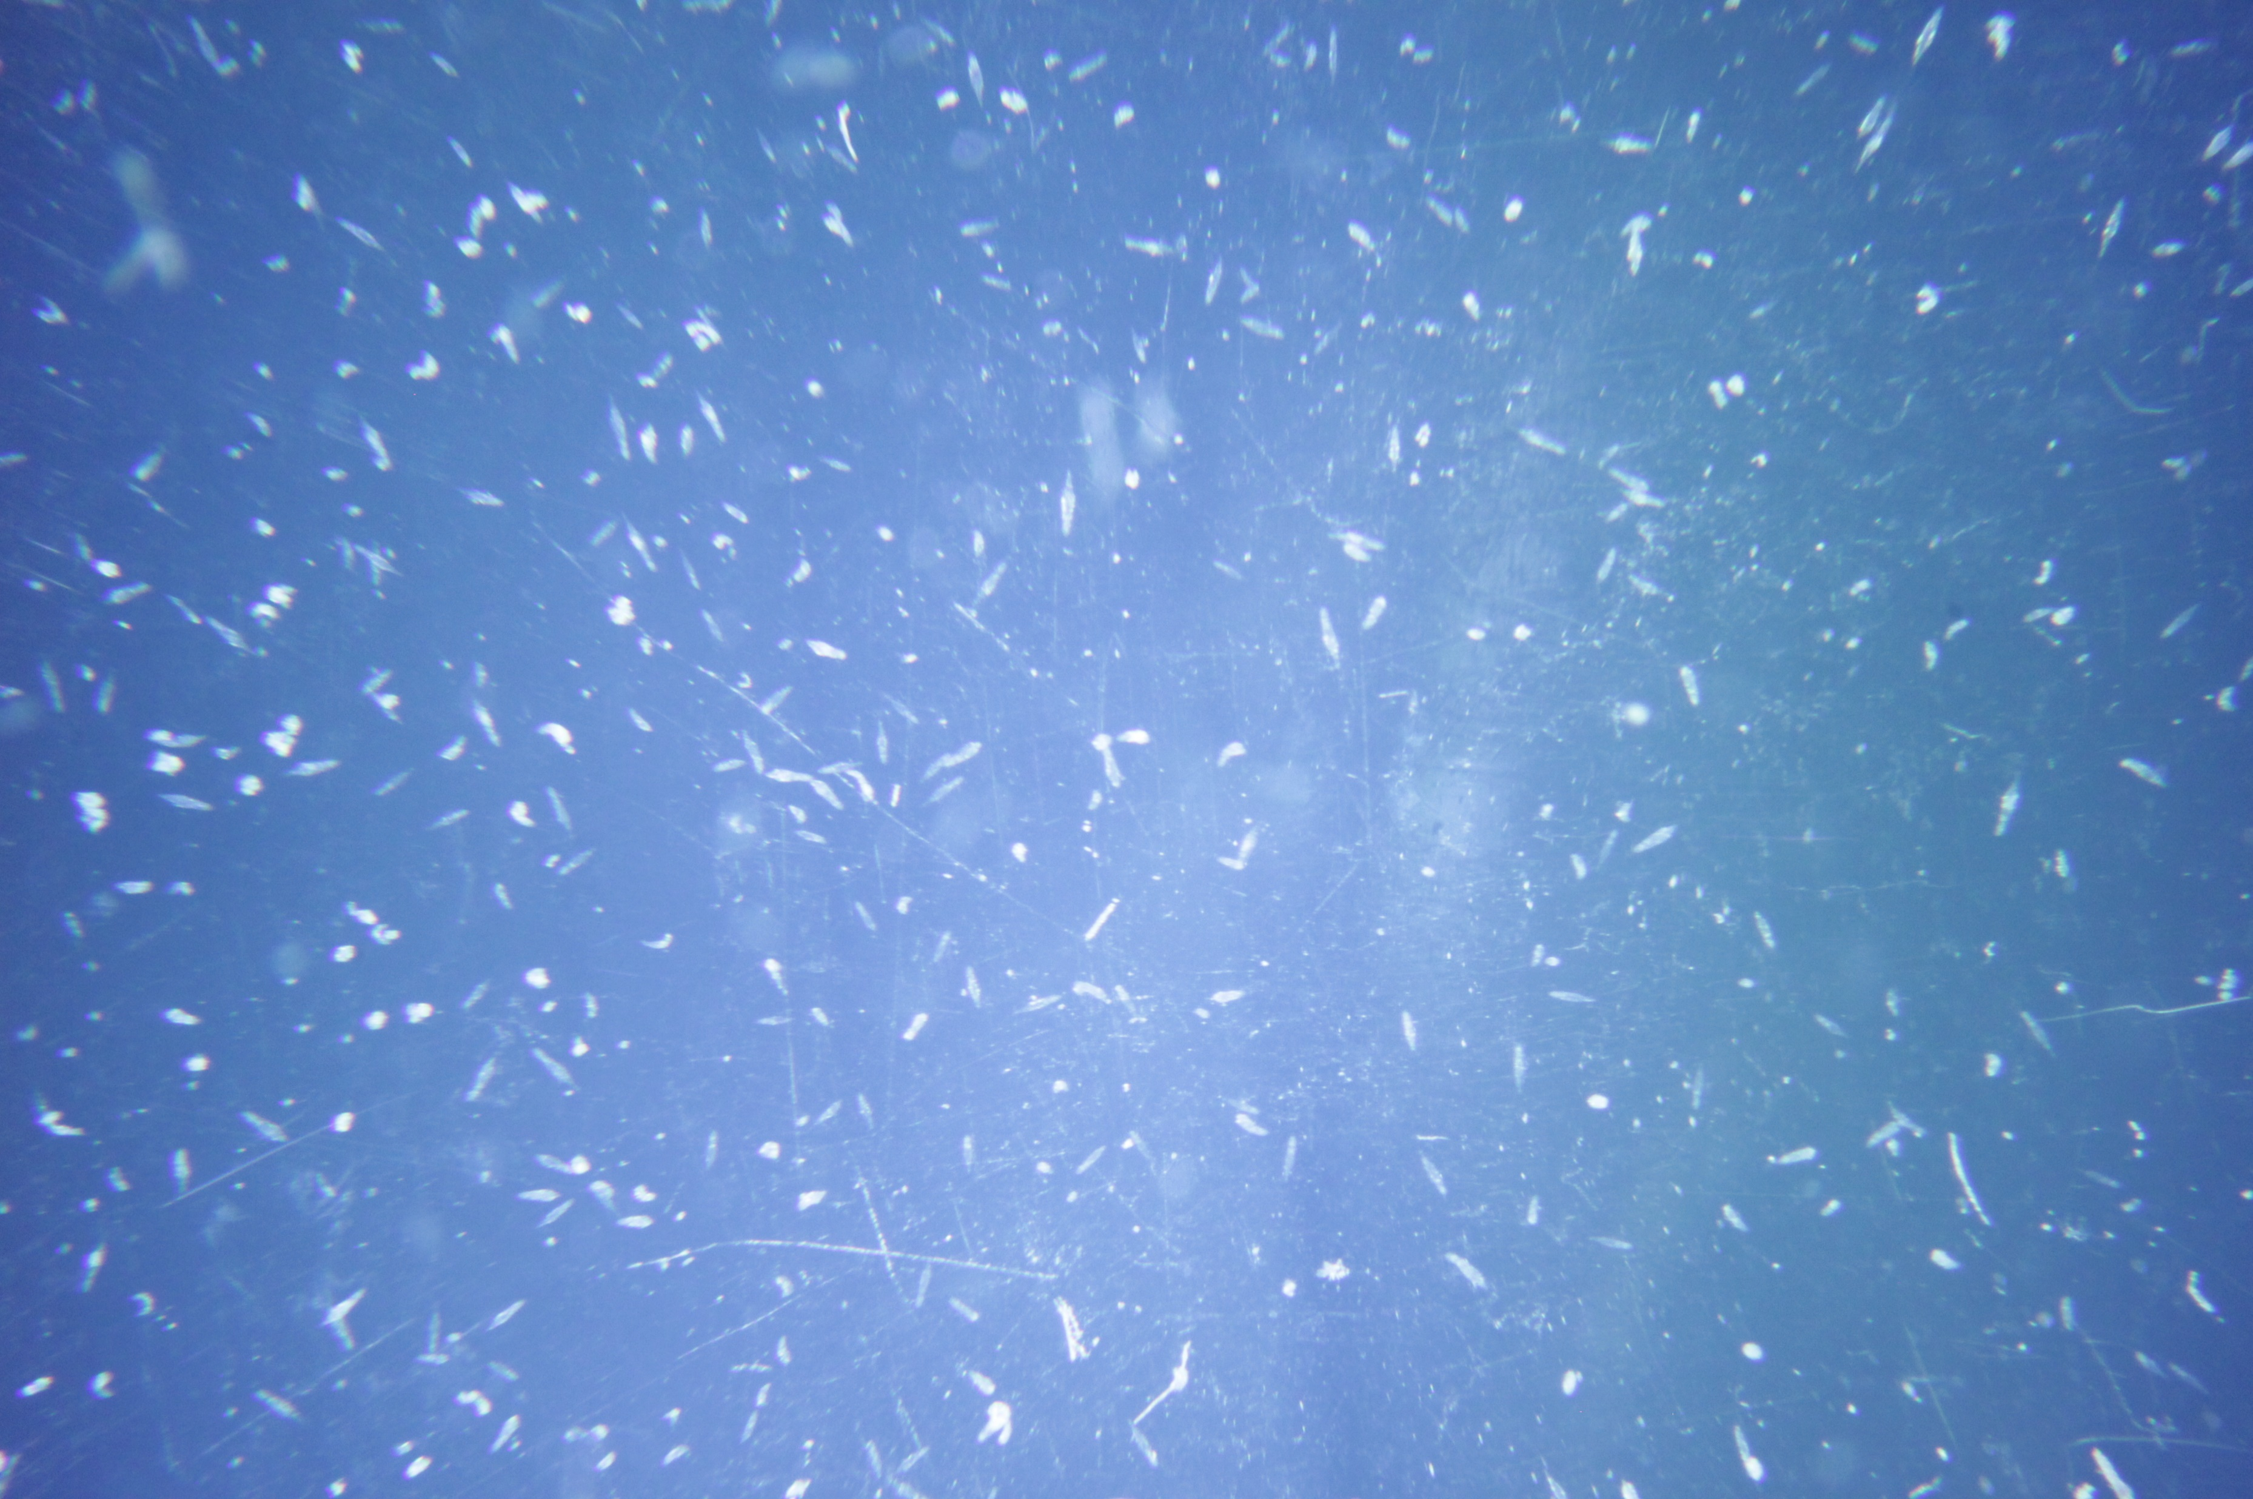
Fixation and Ground controls
Checking the evolution and maintenance of ground controls at KSC.
5 extra visual controls stored inside Science Model
Visual Control-11 day of integration
Visual Control-11 day of fixation

Slide 20
The space environment is hostile and unsuitable for humans
Need of easy and comprehensive model
Why not bdelloid?
“Nothing is easy in Space”
Rob1 = Short term space exposure
Global view of biological processes
Impact at genomic level?

Slide 21
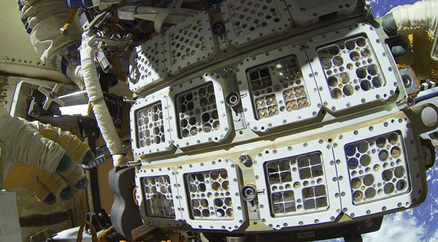
Rob2 (2020)
DNA repair in Space?
RoA (2024)
Astrobiology

Slide 22
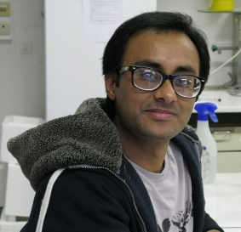
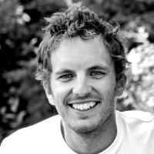
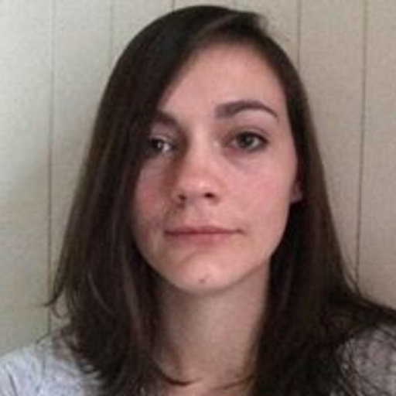
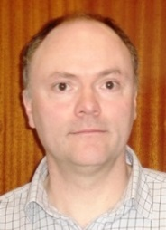
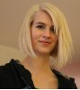
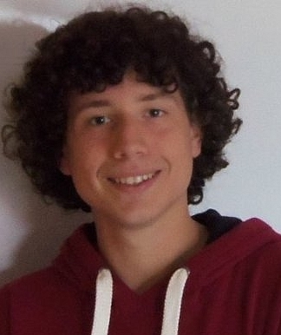
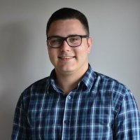
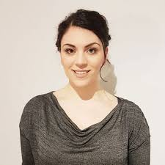
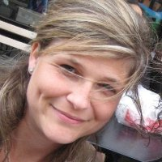
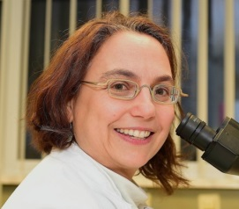
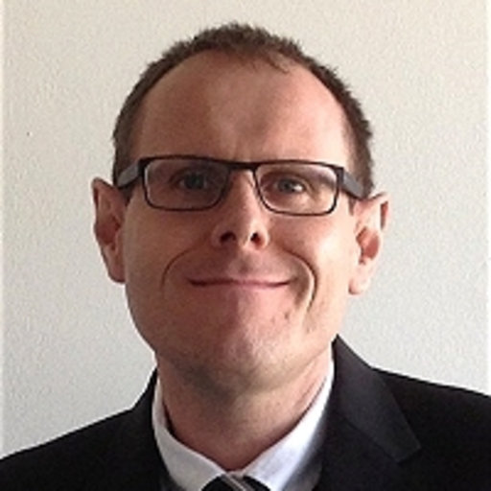
Acknowledgements
Véronique Baumlé
(Unamur)
Lucie Bruneau
(Unamur)
Rohan Arora
(Unamur)
Matthieu Terwagne
(Unamur)
Cecile Bopp
(Unamur)
Bernard Hallet
(UCL)
William
Blaxter (KI)
Alessandra Tortora (KI)
Valerie Cornet (Unamur)
Pr. Karine Van Doninck
(Unamur)
Richard Coos
(Unamur)
Pr. Stéphane Lucas
(Unamur)
Pr. Anne-Catherine Heuskin
(Unamur)
Sebastien Penninckx (Unamur)
Randy Vermeesen
(SCK-CEN)
Rene Demets
(ESA)
Nicol Caplin
(ESA)
Jutta Krauss
(ESA)
Lobke Zuijderduijn (ESA)
Marco Vukich
(ESA)
URBE/LEGE/RISE team, Unamur Communication service, LARN team and SIAM platform, SCK-CEN team, BIOTESC, ESA, Prodex/BELSPO, Vocatio, GSI, DLR, …
http://rotifer-in-space.com/
Bjorn Baselet
(SCK-CEN)
Marjan Moreels
(SCK-CEN)
Sarah Baatout
(SCK-CEN)
Ralf Muller (DLR)

Slide 23
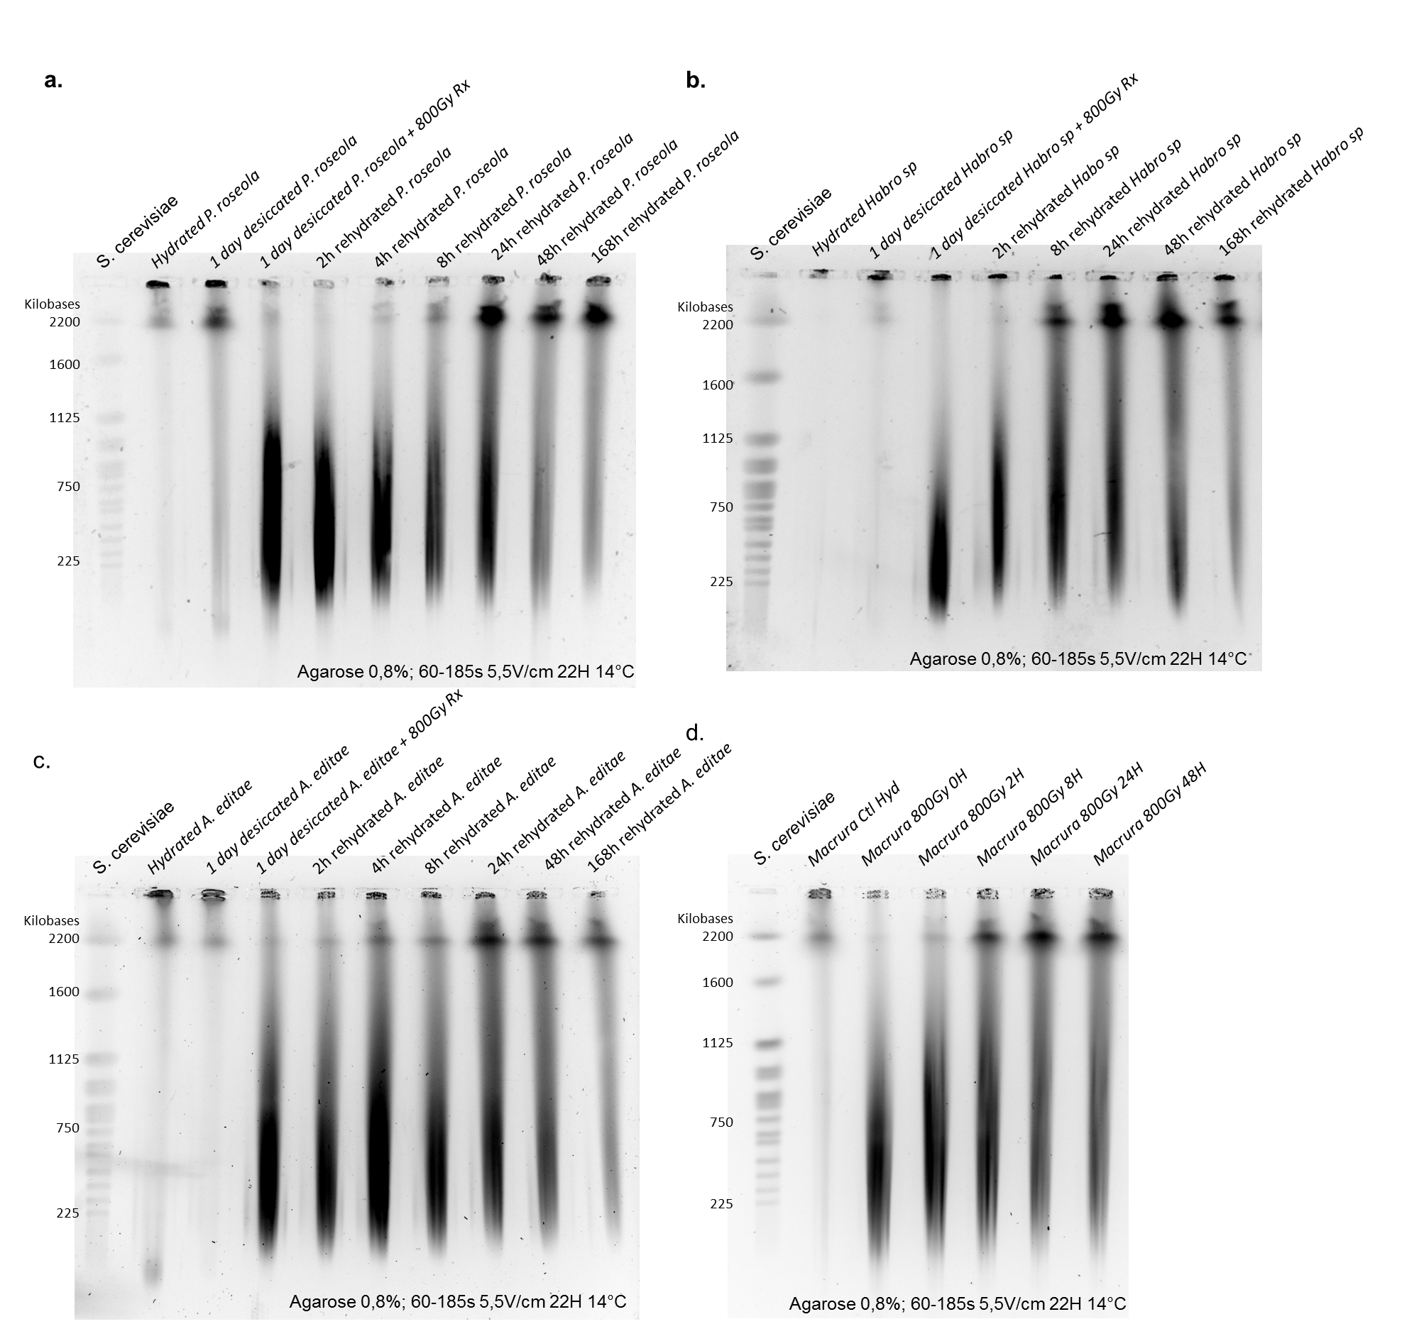
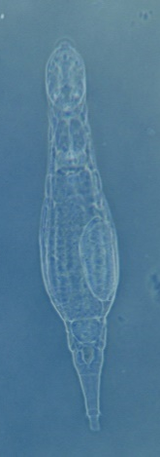
DNA repair among bdelloids… desiccation tolerant or not…
“DNA repair” is uncoupled with capacity to produce viable offspring!

